Slide 1
Prediction of Renal Replacement Therapy application in Heart Failure Patients with a poor response to diuretics
Datathon projects
2018/01/02

Slide 2
Objectives
1.1 To explore the rate of patients who finally came up with Renal Replacement Therapy （RRT） in all the heart failure patients with diuretic resistance in CCU.
1.2 To clarify risk factors of RRT application in heart failure patients with diuretic resistance and build a prediction model of RRT application.
1.3 To clarify the effects of different clinical strategies on mortality to help physicians in making clinical decisions.

Slide 3
Cohort
Include criteria:
A. Patients with ICD-9 include “Heart Failure”,
B. Age>=18 years old
C. Diuretic Resistance （Furosemide >80mg iv /day or>160mg po /day or equal …）
D. Left Ventricular Systolic Function: Moderate or Severe
Exlcude criteria:
A. Not ESRD

Slide 4
Diuretic resistance drug:
-- furosemide > 80 unit:IV
-- furosemide > 160 unit:PO
-- torasemide > 40
-- bumetanide > 2
-- ethacrynic acid > 100
-- lasix > 80 unit:IV
-- lasix > 160 unit:PO
-- torsemide > 40

Slide 5
Outcome
Primary outcome:
Patients come up with dialysis (HD): ICD-9: “Hemodialysis”
Secondary outcome:
Hospital Stay Duration
ICU Stay Duration
In hospital mortality

Slide 6
Data extract
Patient in MIMIN with heart failure, >18
Diuretic resist according to drug use
Exclude ESRD
LVEF is severe
13568
7882
4280
1217

Slide 7
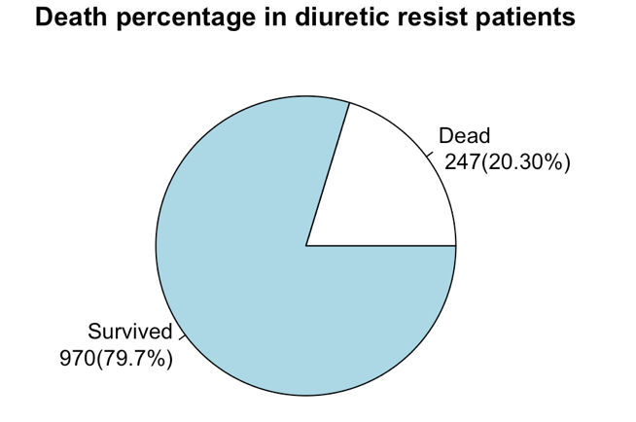
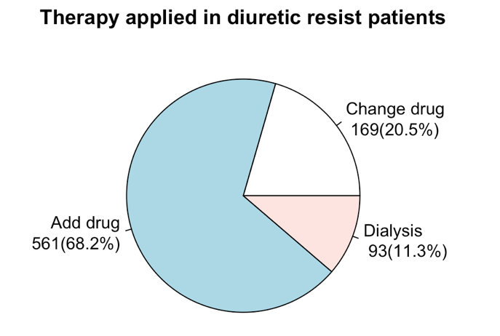
Data visualization

Slide 8
Baseline analysis

Slide 9
Apply logistic regression

